Slide 1
Constructors
Constructor
(Part-1): Basic Things

Slide 2
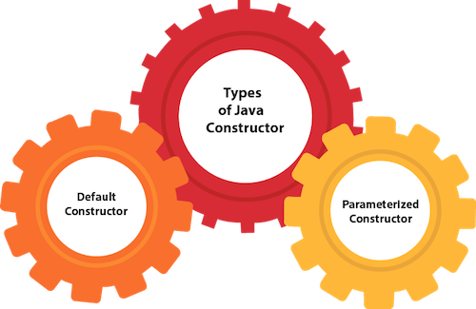
What is Constructors :
In Java, a constructor is a block of codes similar to the method. It is called when an instance of the class is created. At the time of calling constructor, memory for the object is allocated in the memory.
Types of Java constructors
Default constructor (no-arg constructor)
Parameterized constructor

Slide 3
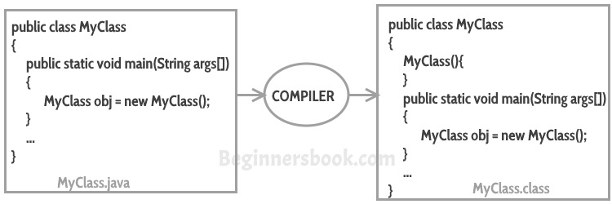
Example of default constructor :

Slide 4
Example of default constructor :
class NoteBook{
NoteBook(){
System.out.println(“Default constructor”);
}
Public void ,ymethod(){
System.out,println(“Void method of the class”);
}
Public satatic void main(String args[]){
Noteb=Book ob = new NoteBook();
Ob.mymethod();
}
}

Slide 5
Java Parameterized Constructor
Example :
class Student4{
int id;
String name;
Student4(int i,String n){
id = i;
name = n;
}
void display(){System.out.println(id+" "+name);}
public static void main(String args[]){
Student4 s1 = new Student4(111,"Karan");
Student4 s2 = new Student4(222,"Aryan");
s1.display();
s2.display();
}
}

Slide 6
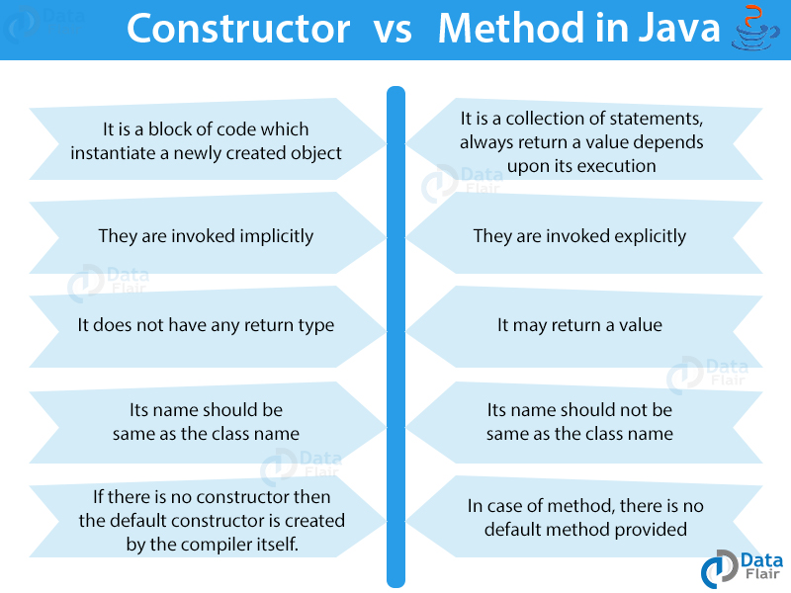
Difference between constructor and method in Java

Slide 7
Constructor Overloading in Java
class Student5{
int id;
String name;
int age;
Student5(int i,String n){
id = i;
name = n;
}
Student5(int i,String n,int a){
id = i;
name = n;
age=a;
}
void display(){System.out.println(id+" "+name+" "+age);}
public static void main(String args[]){
Student5 s1 = new Student5(111,"Karan");
Student5 s2 = new Student5(222,"Aryan",25);
s1.display();
s2.display();
}
}

Slide 8
Java Copy Constructor
To create a copy constructor, we can first declare a constructor that takes an object of the same type as a parameter:
public class Employee {
private int id;
private String name;
public Employee(Employee employee) {
}
}

Slide 9
Then, we copy each field of the input object into the new instance:
public class Employee {
private int id;
private String name;
public Employee(Employee employee) {
this.id = employee.id;
this.name = employee.name;
}
}
}

Slide 10
If the Java class has mutable fields, then we can instead make a deep copy inside its copy constructor. With a deep copy, the newly created object is independent of the original one because we create a distinct copy of each mutable object:
public class Employee {
private int id;
private String name;
private Date startDate;
public Employee(Employee employee) {
this.id = employee.id;
this.name = employee.name;
this.startDate = new Date(employee.startDate.getTime());
}

